Slide 1
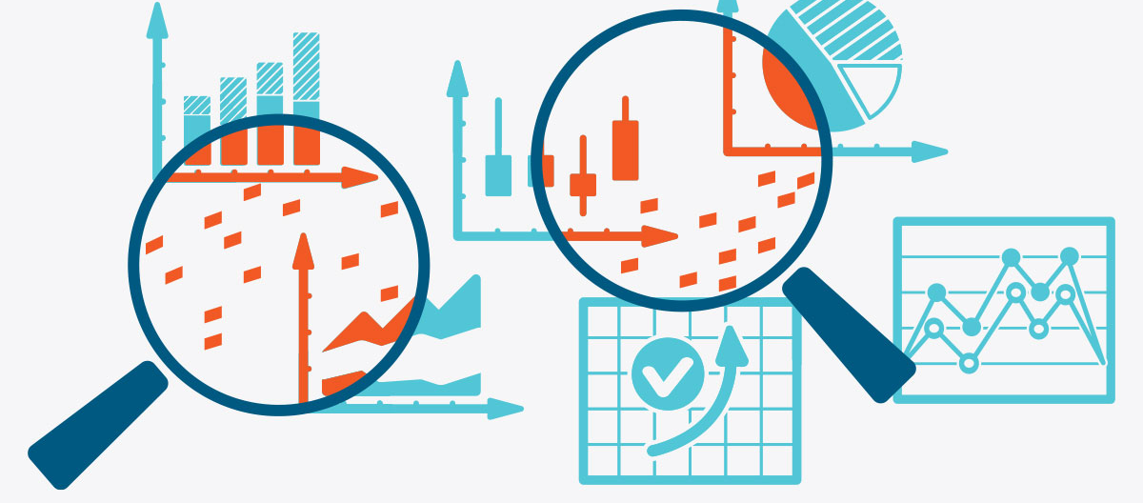
Maji Ndogo Project: Insights Into The Data.

Slide 2
Problem
Uncleaned raw dataset (missing values, duplications, unformatted cells, lack of data formatting etc.).
The raw data has insights related to the level of access to water in various countries that need to be uncovered so that feature engineering can be done.
We need to know the total population of rural and urban individuals and the population count split per region as well as determine the average rate of change of the level of access to water across regions.
We need quantitative indicators on the change of infrastructural development in each of the regions so that we know which regions to prioritise to increase the level of access to basic water services.
Prepare the data for the next step which is querying the data using SQL and feature engineering. [deep dive into the data]

Slide 3
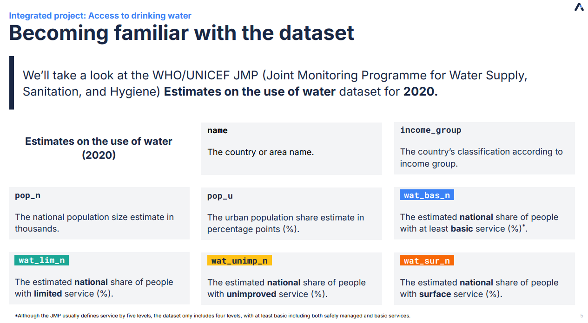
Becoming Familiar with the Dataset

Slide 4
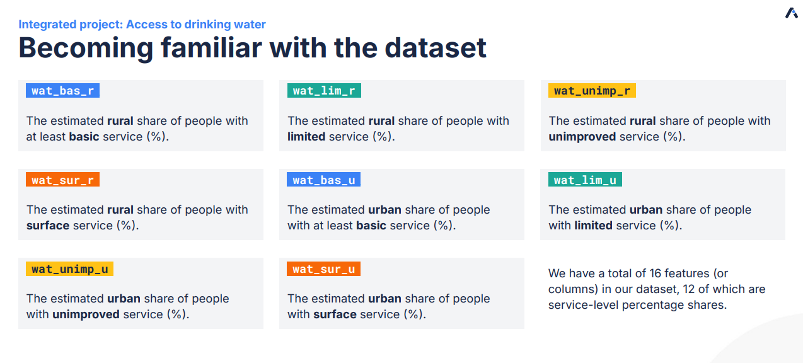
Becoming Familiar with the Dataset

Slide 5
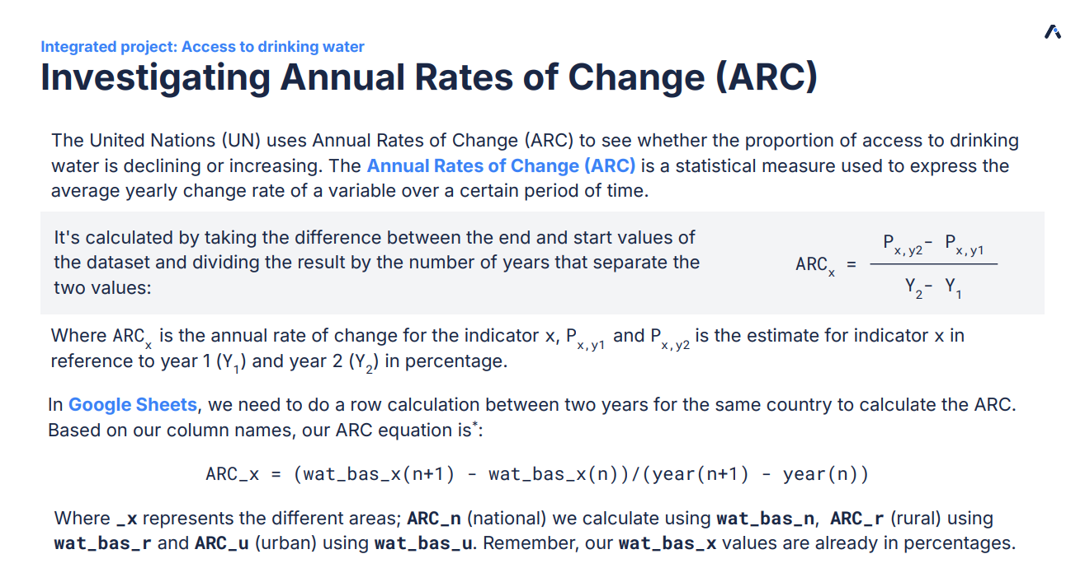
Process:
The ARC of the data set was calculated by taking the national, urban and rural percentage share of the level of access to basic water [wat_bas_()] for each country over 2 separate year periods. The sum of all the countries’ individual arcs was then added to get the total sum categorised per region each of the countries fall under.
Becoming Familiar with the Dataset

Slide 6
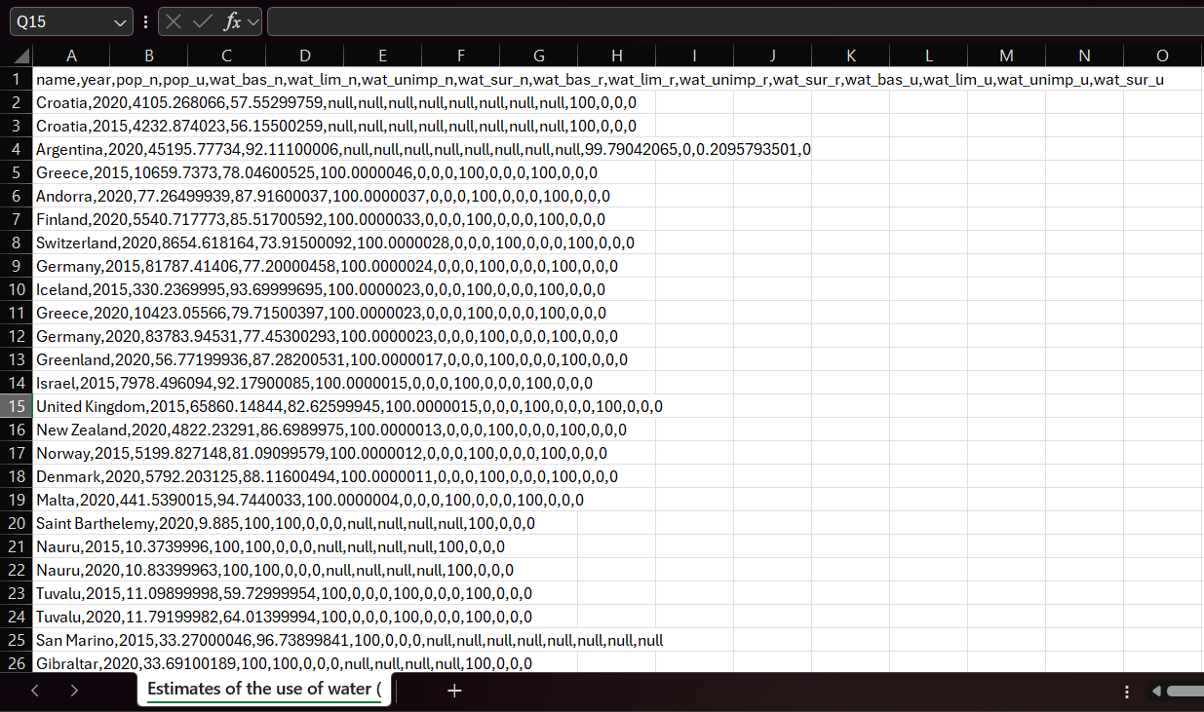
Raw Dataset

Slide 7
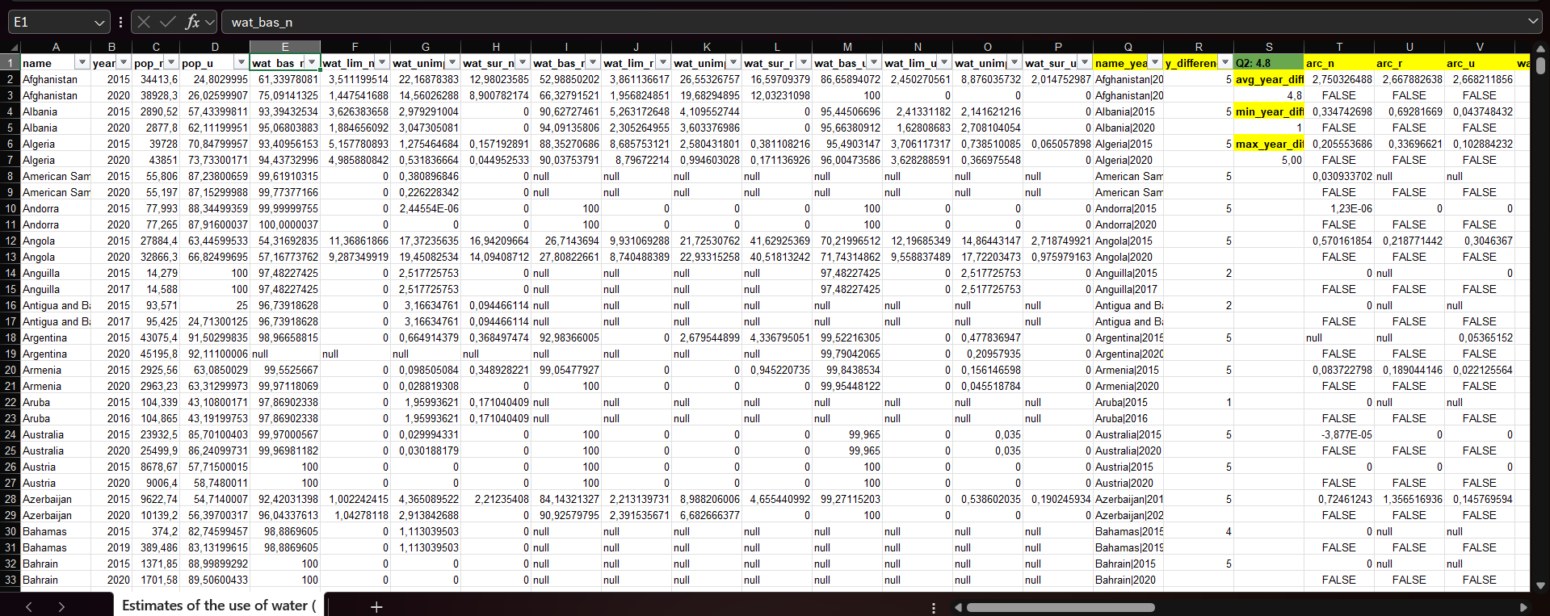
Cleaned and Organised Data

Slide 8
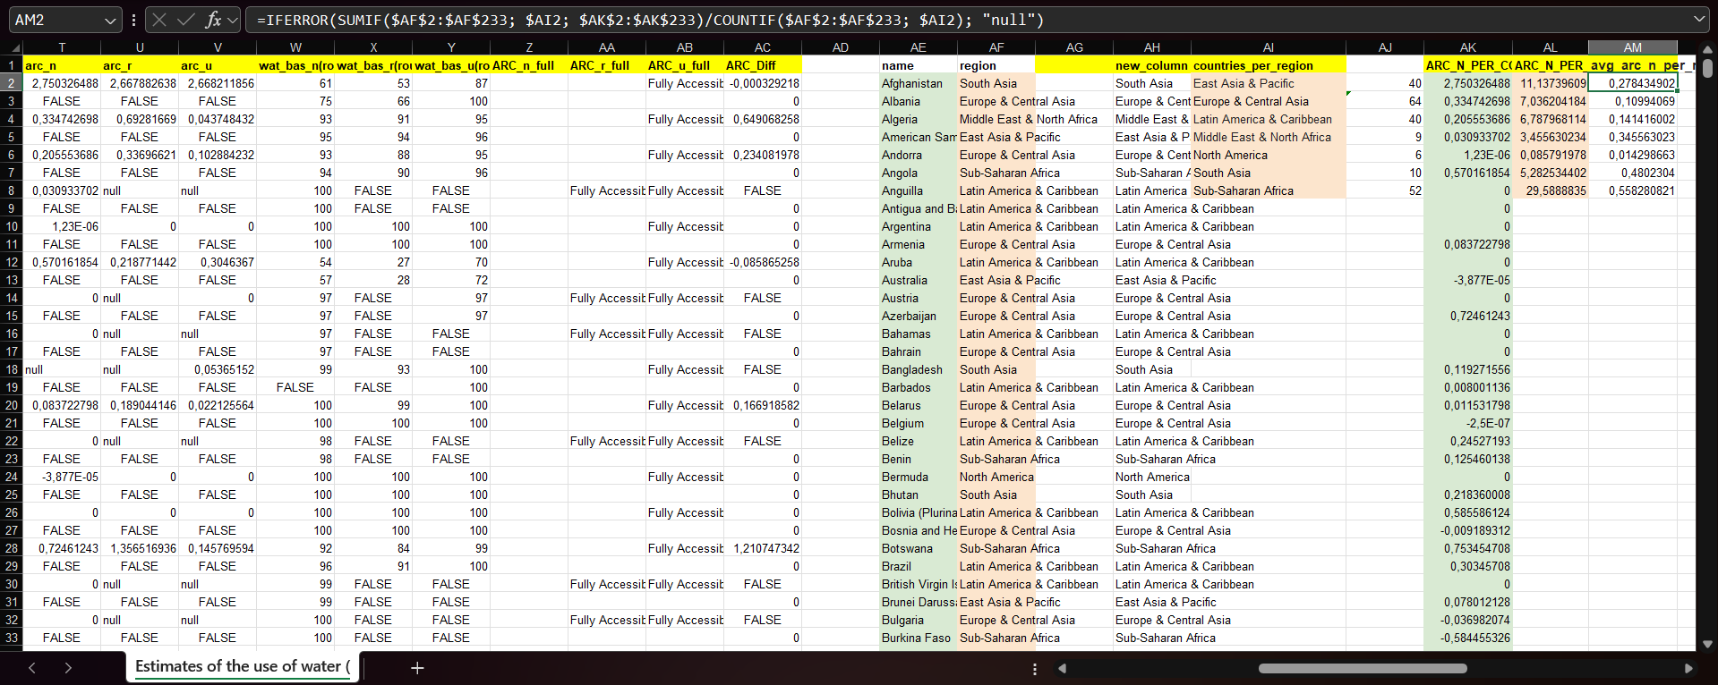
Feature Engineering

Slide 9
Sub-Saharan Africa, Latin America and Caribbean and Europe and Central Asia rank among the highest in population count in the Maji Ndogo data set.
This graph gives us valuable insight into the proportion of individuals affected by basic water access levels in Maji Ndogo and also paint a picture of how much the lack of access to water affects predominantly third world countries. This is a problem that is exacerbated by structural inequalities and inefficiencies experienced by the significantly affected countries.

Slide 10
Total Rural Population: 10 015 519
Total Urban Population: 14 842
Sub-Saharan Africa has the highest proportion of rural population where rural areas are often known for their infrastructural deficiencies especially regarding basic service provision e.g.: water access, healthcare, municipal plumbing and electricity etc. This highly negatively impacts their level of basic water access.
Efforts should primarily be directed in the rural areas namely; Sub-Saharan Africa and Latin America and Central Asia in order to equal the population’s level of access to basic water service with the urban region.

Slide 11
The ARC values listed here illustrate the rate of change of the share percentage of people’s access to basic water services per country per region. A higher ARC value means there have been infrastructural water developments in the region to provide access to basic services to the people.
Comparing the ARC value against the national population count also give a better picture on the extent and volume of developments undertaken to improve basic water access to different regions.
Sub-Saharan Africa, Middle East and North Africa and South Asia are among the most underdeveloped regions globally. The are also the most prioritised in this project hence their high ARC values comparatively.

Slide 13

Conclusion

